Slide 1
Project Update #1
GEOG 788P – Methods and Models in Spatial Data Analysis
Fall 2021
Kha-Ai Tran

Slide 2
Topic
How does the relationship between agricultural health/productivity and temperature change over time?
Primary Outcome: One or more maps illustrating changes over time and potentially predictive model of how agriculture may change in the future if an existing trend in temperature continues over the next several years. Analysis and interpretation will accompany any produced maps.
Potential Alternative (or bonus): How does the relationship between agricultural health (or productivity) and invasive species change over time? In relation to temperature or another climate change metric?
Notes:
Spatial analysis of agricultural productivity and vegetation/land cover across the United States with relation to changes in air or surface temperature over time.

Slide 3
Background
Climate change has and will have significant impact on agriculture.
Temperature and precipitation especially can have significant impact on annual crop yield.
In 2017, 40% of land in the U.S. were farms. This is a significant proportion and understanding climate change impacts on agriculture is critical to a major sector of the U.S.
Additionally, many invasive species have also been known to expand their territory and footprint, as well as grow in volume with the increase in globalization as well as changing climate.
Changing climates change the ecosystem, sometimes detrimental to native species by pushing them out of their natural habitats (whether through migration or disease and death) and creating habitats supportive of growing invasive species.
Invasive species can destroy forests, damage crops, spread diseases (some of which can devastate croplands), and more.
Notes:
https://www.nass.usda.gov/Publications/Highlights/2019/2017Census_Farms_Farmland.pdf
https://nifa.usda.gov/topic/invasive-pests-and-diseases

Slide 4
Data
Raster
TIFF
GEOTIFF
Vector
Points
Polygons
Table
CSV
TXT

Slide 5
Data
 | Data Type
Source | Raster | Vector | Table
NOAA Climate data
USDA Agriculture data
Cropscape Agriculture data
Earthstat Agriculture and Vegetation data
U.S. Forest Service Invasive Species data
U.S. Fish and Wildlife Service Boundaries data
USGS Land Cover data
U.S. Bureau of Land Management Land Use data

Slide 6
Data Exploration
Datasets have different spatial units → data processing needs to be done before analysis:
Determine optimal spatial scale for analysis
Table and spatial joins
Focus on a specific region if necessary depending on data availability

Slide 7
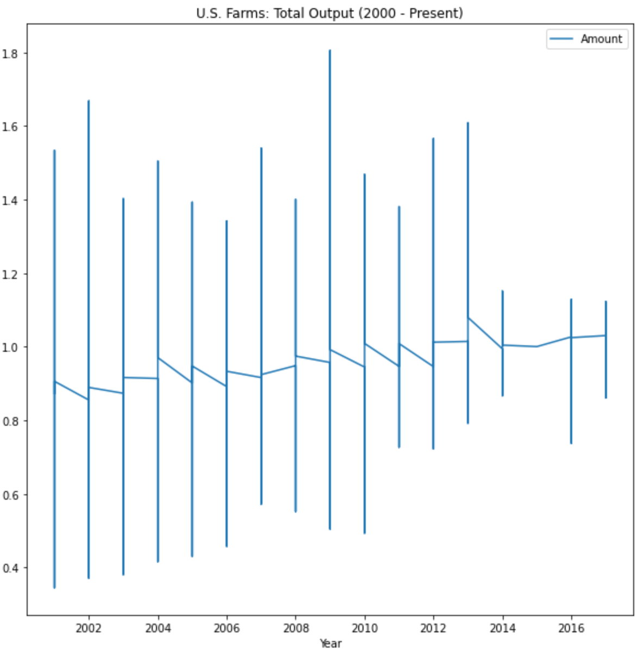
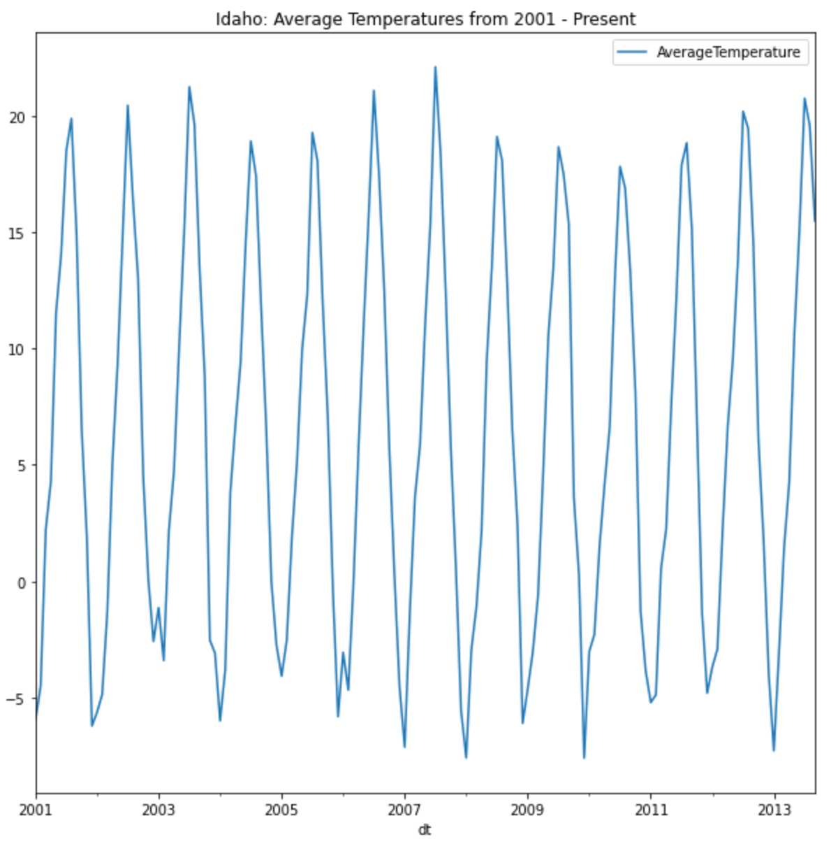
Data Exploration

Slide 8
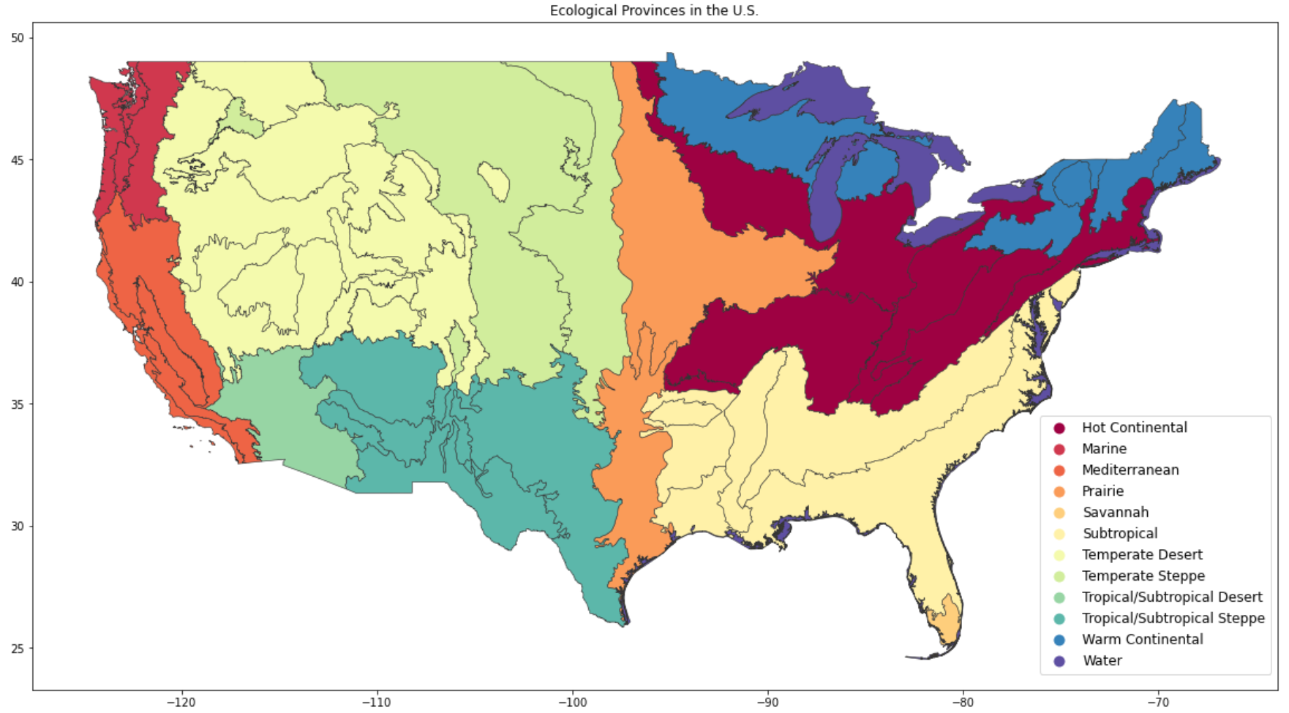
Data Exploration

Slide 9
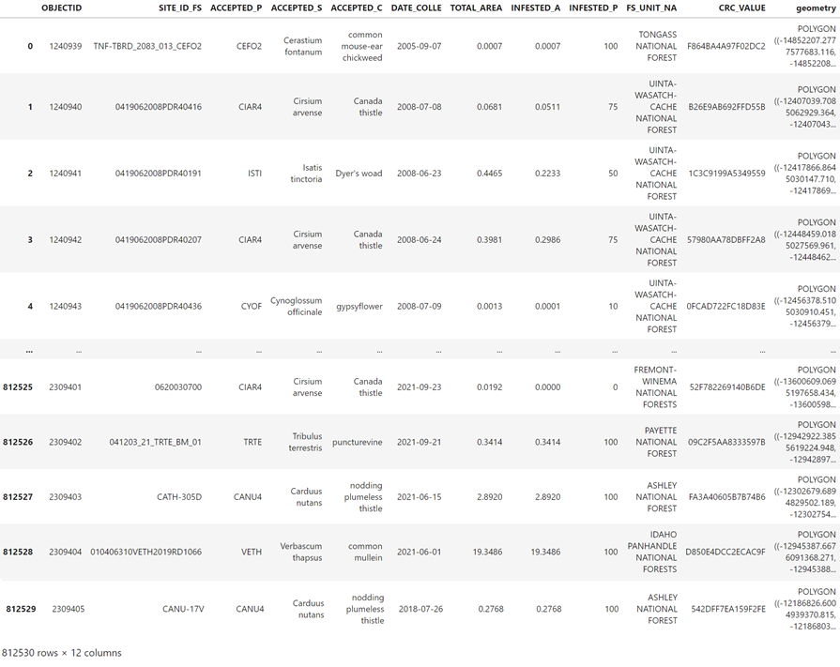
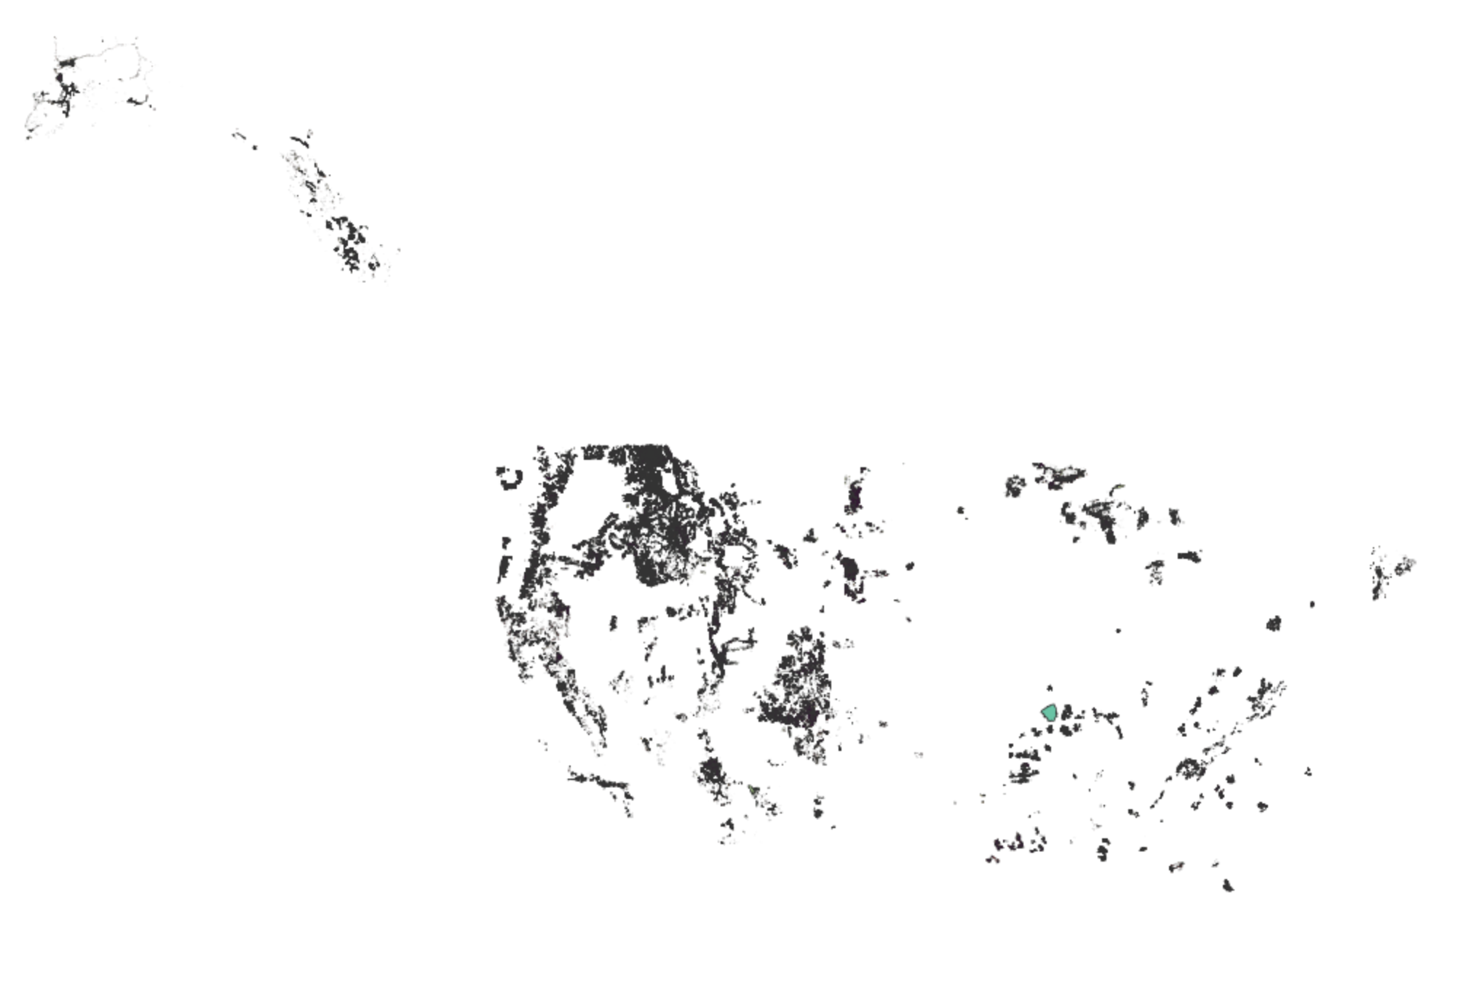
Data Exploration
Current Invasive Plants

Slide 10
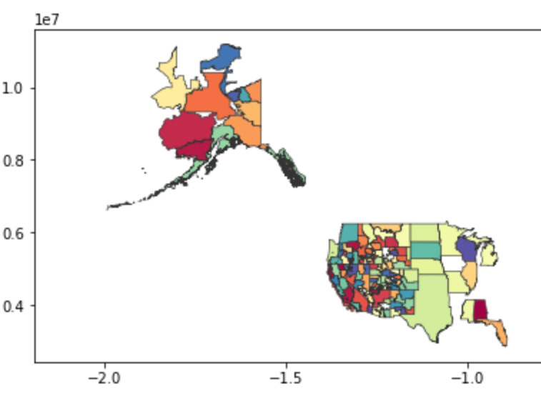

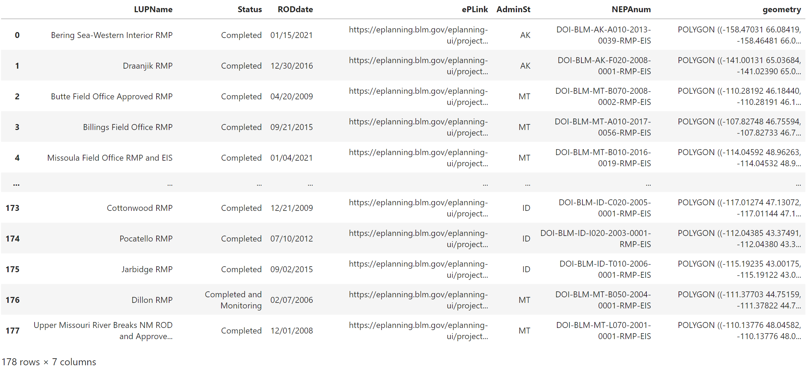
Data Exploration
Land Use Planning Areas (Grazing)

Slide 11
Data Analysis
Data cleaning and processing
Exploratory regression analysis on relationship of vegetation, agricultural productivity, and land use against climate change data (temperature as the beginning metric)
Exploratory regression analysis on relationship of agriculture attributes and invasive species territory (focus on amount of area covered by all relevant invasive species)
Cluster or optimized hot spot analysis on specific attributes of interest depending on results of exploratory regression analysis (digging deeper into statistically significant variables)
Potentially incorporate GWR to analyze the extent to which invasive species territories impacts agriculture (e.g. how much territory or how far from farms do invasive species need to be to begin impacting agriculture?)

Slide 12
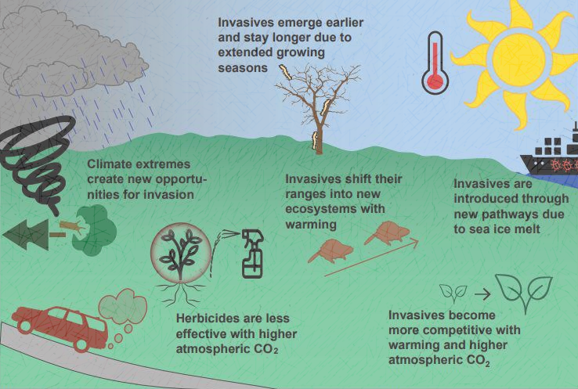
Questions?
Notes:
"Regional Invasive Species & Climate Change Management Challenge: Doubl" by Bethany A. Bradley, Evelyn M. Beaury et al. (umass.edu)

